Slide 1
External Flow:
The Flat Plate in Parallel Flow
Chapter 7
Section 7.1 through 7.3
Appendix F

Slide 2
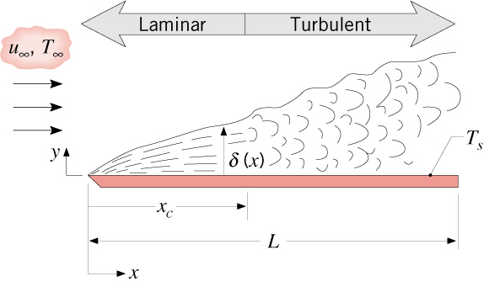
Physical Features
Physical Features
As with all external flows, the boundary layers develop freely without constraint.
Boundary layer conditions may be entirely laminar, laminar and turbulent,
or entirely turbulent.
To determine the conditions, compute
and compare with the critical Reynolds number for transition to turbulence,

Slide 3
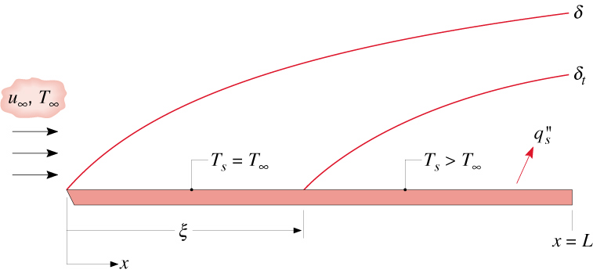
Physical Features (cont.)
Value of depends on free stream turbulence and surface roughness.
Nominally,
If boundary layer is tripped at the leading edge
and the flow is turbulent throughout.
Surface thermal conditions are commonly idealized as being of uniform
temperature or uniform heat flux .
Is it possible for a surface to be
concurrently characterized by uniform temperature and uniform heat flux?
Thermal boundary layer development may be delayed by an unheated
starting length.
Equivalent surface and free stream temperatures for and uniform
(or ) for .

Slide 4
Similarity Solution
Similarity Solution for Laminar,
Constant-Property Flow over an Isothermal Plate
Based on premise that the dimensionless x-velocity component, ,
and temperature, , can be represented exclusively in
terms of a dimensionless similarity parameter
Similarity permits transformation of the partial differential equations associated
with the transfer of x-momentum and thermal energy to ordinary differential
equations of the form
and

Slide 5
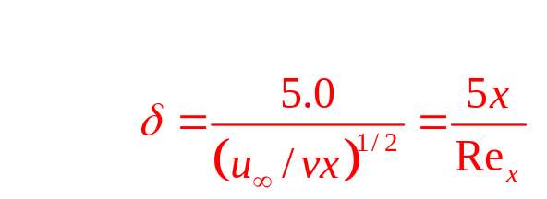
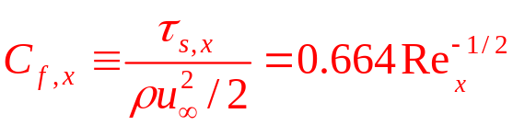
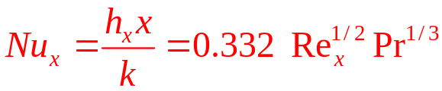
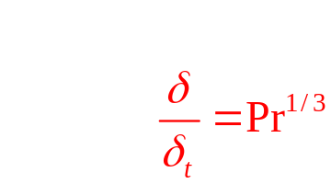
Similarity Solution (cont.)
Subject to prescribed boundary conditions, numerical solutions to the momentum
and energy equations yield the following results for important local boundary layer
parameters:

Slide 6


Similarity Solution (cont.)
How would you characterize relative laminar velocity and thermal boundary layer
growth for a gas?
An oil?
A liquid metal?
How do the local shear stress and convection coefficient vary with distance from
the leading edge?
Average Boundary Layer Parameters:
The effect of variable properties may be considered by evaluating all properties
at the film temperature.

Slide 7
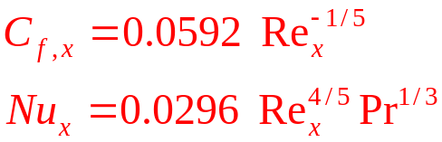

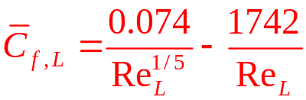

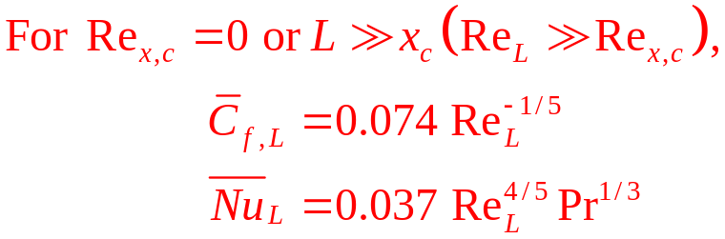
Turbulent Flow
Turbulent Flow
Local Parameters:
Empirical
Correlations
How do variations of the local shear stress and convection coefficient with
distance from the leading edge for turbulent flow differ from those for laminar flow?
Average Parameters:
Substituting expressions for the local coefficients and assuming

Slide 8
Special Cases
Special Cases: Unheated Starting Length (USL)
and/or Uniform Heat Flux
For both uniform surface temperature (UST) and uniform surface heat flux (USF),
the effect of the USL on the local Nusselt number may be represented as follows:
 | Laminar |  | Turbulent
 | UST | USF | UST | USF
a | 3/4 | 3/4 | 9/10 | 9/10
b | 1/3 | 1/3 | 1/9 | 1/9
C | 0.332 | 0.453 | 0.0296 | 0.0308
m | 1/2 | 1/2 | 4/5 | 4/5
Sketch the variation of h_{x} versus for two conditions:
What effect does an USL have on the local convection coefficient?

Slide 9

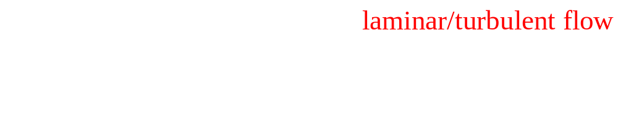
Special Cases (cont.)
UST:
USF:
Treatment of Non-Constant Property Effects:
Evaluate properties at the film temperature.

Slide 10
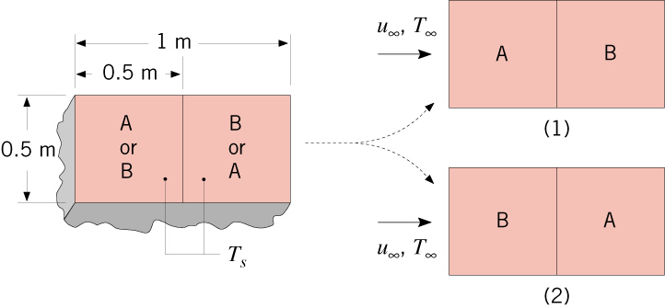
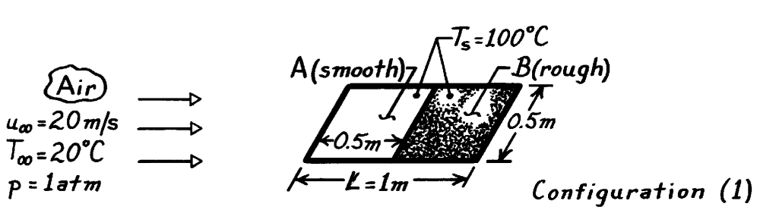
Problem: Orientation of Heated Surface
Problem 7.21: Preferred orientation (corresponding to lower heat loss) and the corresponding heat rate for a surface with adjoining smooth and roughened sections.

Slide 11
Orientation of Heated Surface (cont.)

Slide 12
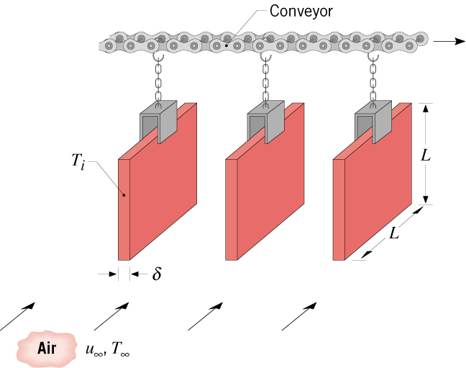
Problem: Conveyor Belt
Problem 7.25: Convection cooling of steel plates on a conveyor by
air in parallel flow.

Slide 13

Problem: Conveyor Belt (cont.)

Slide 14
Problem: Conveyor Belt (cont.)

